Slide 1






TEMPO Validation and
Early-users Workshop
Mike Newchurch and the
TEMPO validation team
Brad Zavodsky and the
SPoRT team
1-2 June 2016
4th TEMPO Science Team Meeting
National Museum of the American Indian
Washington, DC

Slide 2
PLRA Section 4.1.1.b
Baseline Cal/Val
Purpose: identify and correct regional-scale and diurnal systematic biases in the space-based products and demonstrate required precisions in polluted clear-sky scenes to the levels listed in the PLRA Table
Approach: Compare space-based and ground-based retrievals of products using correlative data collected from:
  daytime (solar zenith angles <70° for all products) observations
  at least one month each season
  from at least three (3) ground validation sites in the US
At the validation sites, Pandora solar spectral-radiometer measurements will be the primary source of correlative data for trace gas column densities.
Ozonesondes and TOLNet will contribute to the validation of the O3 mixing ratio on a best-effort basis.

Slide 3
Validation Side Note
TEMPO Level 1b Radiance product has no PLRA requirement, and hence no validation promise.
However, it will be evaluated to the extent necessary to produce the Level 2 Baseline data products.
Evaluation will most likely rely upon measurement vs. radiative transfer model comparisons.
If radiance measurements from other appropriate space-based instruments, i.e. TropOMI, or air-borne instruments, i.e. GEOTaso, are available they’ll also be examined.
Likewise, validation of the cloud product is not a PLRA requirement, but it will be evaluated as an intermediate product in the Level 2 processing.

Slide 4

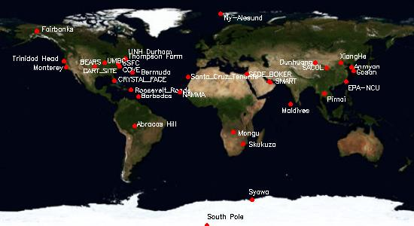
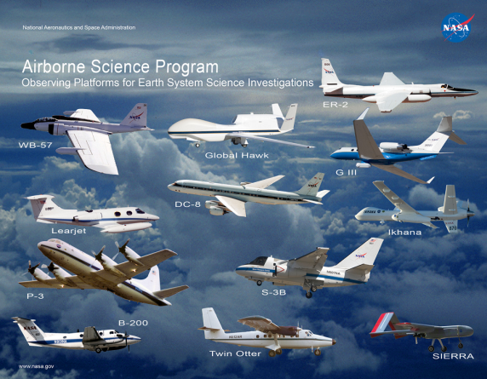
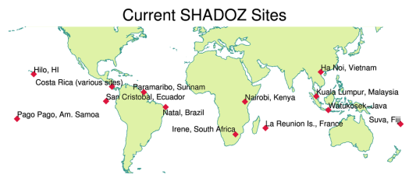
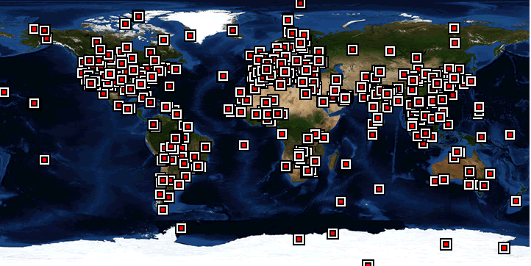
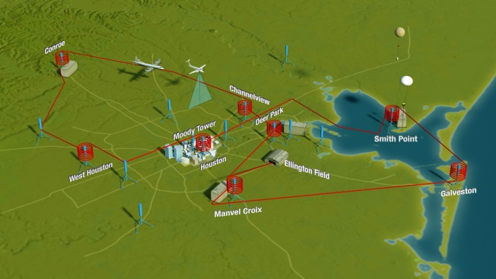
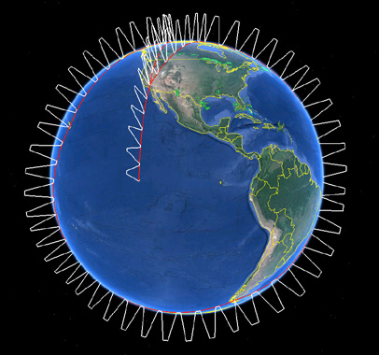
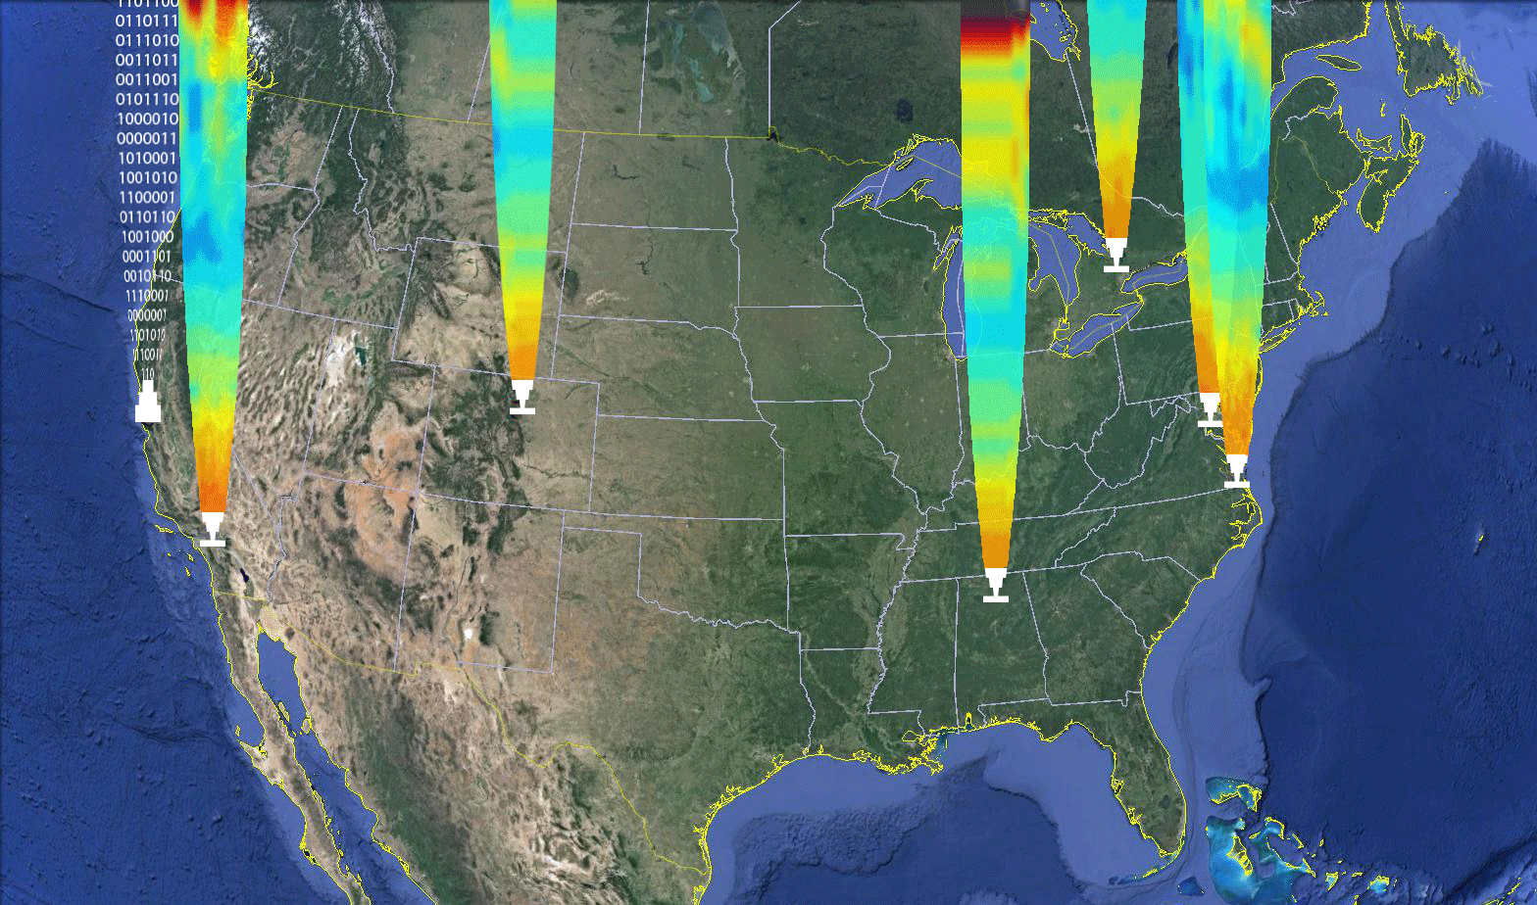
Examples of Contributing Activities
Surface-Based Measurement Networks
NASA Airborne Science Fleet
MPLNet
SHADOZ
DISCOVER-AQ Mission
AToM Mission
AERONET
TOLNet
TORONTO
AMES
ESRL
GSFC
Tropospheric Ozone LIDAR Network
JPL
LaRC
UAH

Slide 5
Context: What we would like to do
Objective: Validate Baseline products: L-1b radiances, NO2, O3, SO2, C2H2O2, HCHO, AOD, AAOD, Cloud Fraction, Cloud-top Pressure, Geo-location accuracy
  Development uncertainty estimates of PBL mixing-ratios
  Establish data credibility within the Air-Quality Community
Mindset: Hourly 5x5 km observations.
  Think high-resolution temporal and spatial evolution
  Work to overcome limited vertical resolution
Details:
  PLRA table Products and schedule and GSICS: Dave Flittner
  Federated activities leverage (PAMS/NCore, CASTNet, CSN, and IMPROVE), along with research networks SPARTAN and BEACO2N, along with Canadian and Mexican assets.): Jim Szykman
  Modeled/measured radiances: Brad Pierce
  Pandora columns and vertical information: Jay Herman
  Surface remote-sensing/profiling networks and research sites: TOLNet, NDACC, Pandora, Ozonesonde, Brewer/Dobson, CAPABLE, AIRS, NAPS (Canada), and Mexican assets
  Aircraft campaigns: Jim Crawford
  ACAM/GCAS/Geo-TASO: Liu/Abad
  A/C validation of OMI H₂CO : Abad
  Space-borne instruments including OMI, GOME-2, NPP/OMPS, TROPOMI, and Sentinel 5
  Students: Margaret Pippin
Validation plans:
  H₂CO: Jim Szykman/Herman
  NO₂: Ron Cohen
  O₃: Mike Newchurch
  International collaborations/intercomparisons: Korean Geostationary Environmental Monitoring Spectrometer (GEMS) providing O3, NO2, H2CO, SO2, and aerosol products, the European Sentinel 4 and 5P missions providing O3, NO2, H2CO, C2H2O2, SO2, H2O, and aerosol products, the NASA/NOAA NPP/OMPS providing O3, and the Global Space-based Inter-calibration System (GSICS). Newchurch/Al-Saadi/Liu/Abad

Slide 6
Validation ideas
Remote continental locations at middle latitudes with homogeneous and easily predictable surface reflectivity, simple homogeneous landscape, low cloud cover. These sites are important for validation of satellite retrievals under favorable conditions. In addition, they can provide long-term measurements of mainly stratospheric NO2 and O3 columns.
Remote continental locations at middle latitudes with less favorable satellite retrieval conditions
Multiple validation instruments within heterogeneous locations such as big cities, coastal areas, city edges, etc.
High latitudes with challenging SZA and reflectivity's etc.
Examine repeats at a power plant with near-constant emissions and check that there is little variation of NO₂ with time of day.

Slide 7


Slide 8
TEMPO Validation Capabilities
Pandora NO₂
Total and tropospheric columns of NO2 from direct sun measurements -> column along a narrow cone (0.5º)
Tropospheric NO2 column from MAX-DOAS measurements -> averaged column along viewing horizontal direction (1-10 km)
Near surface concentration -> averaged concentrations along 1-10 km in horizontal direction and 100-200 m in vertical direction
Profile information is limited -> averaged profile along 1-10 km in horizontal direction and 1-2 km in vertical direction; actual spatial coverage depends on aerosol loading conditions and viewing azimuth direction. A narrow slice of the atmosphere.

Slide 9
Pandora TEMPO validation capabilities
Three products will be available from the MAX-DOAS data:
  Real time near surface concentrations
  Total tropospheric columns
  Profile information of NO₂, HCHO, O₃, SO₂, H₂O
Fast azimuthal scans can provide “areal” view with a diameter of 2-20 km
Deploying multiple Pandoras at the same location will increase temporal resolution

Slide 10
Pandora Locations
Current sites: NASA/HQ; GSFC; Four Corners; Boulder; Houston; 2x eastern Canada; 2x SAO; St. Louis
By end of 2016: Richmond, VA; CCNY; Huntsville, UMD eastern shore; 2nd Pandora @ Boulder/NOAA, then 1st Boulder unit to JPL (TMF?)
2016 or 2017: UMCP, UMBC
>2016: Desire for one in Mexico City

Slide 11
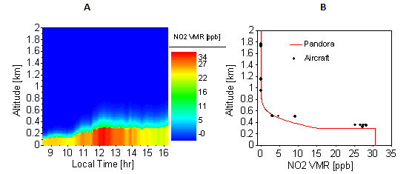
Profiles of NO₂ Compared with Aircraft Measurements Discover-AQ
Variation of Boundary Layer
NO₂ Profile
NO₂ profiles derived from Pandora direct-sun and MAXDOAS observations over Fresno, California on 18-Jan-2013
Comparison of Pandora retrieval to aircraft (P3B) measured NO₂ profile (Fresno California).

Slide 12
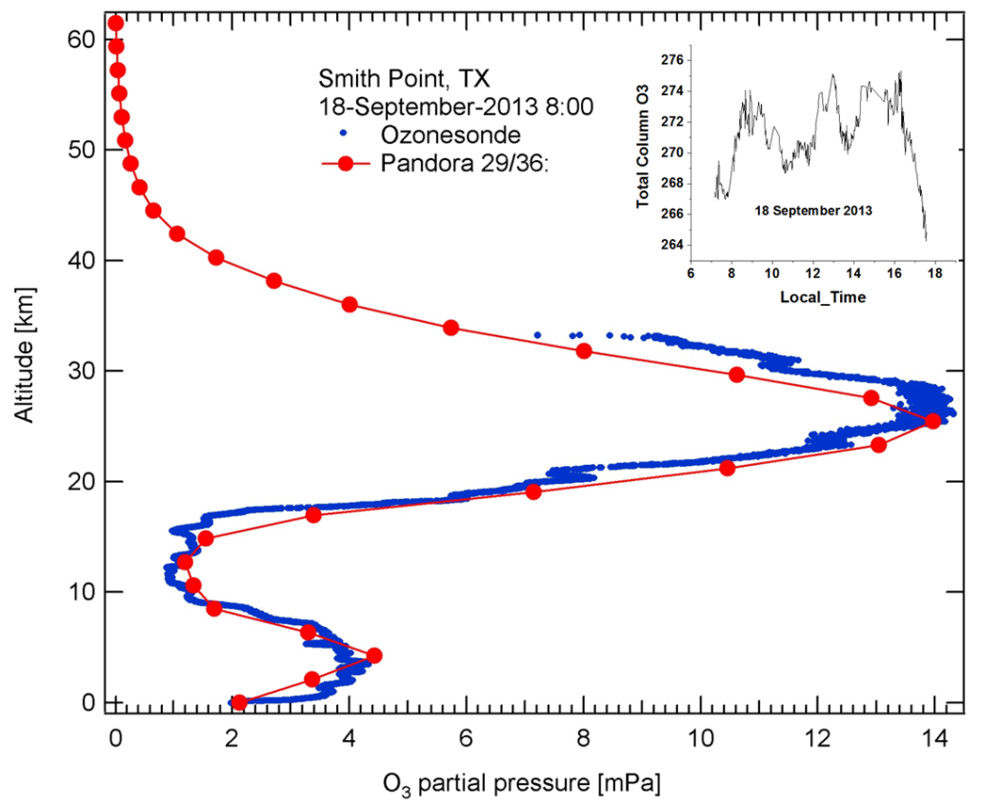
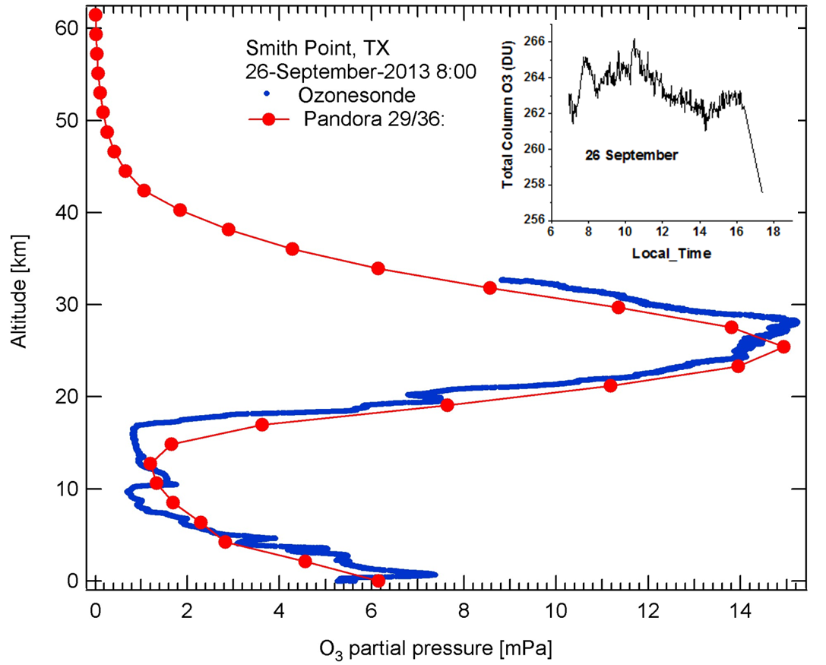
Pandora Measurements of Ozone Profiles Compared with O₃ Balloon Sondes
Smith Point, Texas on Sept 18 and 26, 2013
Pandora O₃ Profile
Notice the profile agreement in the Troposphere
Balloon Sonde O₃ Profile

Slide 13
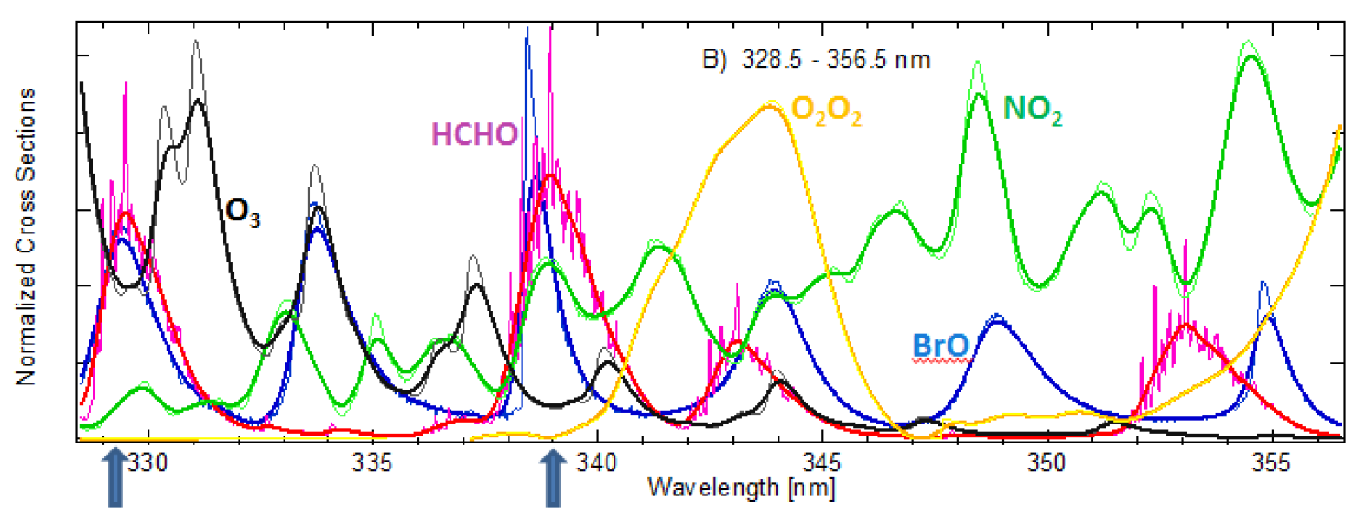
Basic Reason for Echelle Grating Spectrometer Studies
Find a Window at 0.6 nm that gives a good answer for HCHO
High resolution (0.03 nm per FWHM) and low resolution (0.5 nm per FWHM) normalized absorption cross sections of HCHO [Chance and Orphal, 2011; 300K], O₃ [Macilet et al., 1995; 228K], NO₂ [Vandaele et al., 1998 220K], BrO [Fleischmann et al., 2004; 223K] and O₂O₂ [Hermans et al,. 2003] (arbitrary scale): A) from 315 to 370 nm and B) OMI fitting HCHO wavelength region from 328.5 to 356.5 nm. Arrows indicate the major cross correlation regions.

Slide 14
Ozone

Slide 15




Structure, Capabilities, and Accomplishments of the Tropospheric Ozone Lidar Network, TOLNet, for Background Ozone Determination
ENV-Vision; May 10-11, 2016; Washington D.C.
TOLNet
TORONTO
AMES
ESRL
GSFC
Tropospheric Ozone LIDAR Network
JPL
LaRC
UAH
Jack Kaye¹, Barry Lefer¹, Matthew Johnson², Thierry Leblanc³, Raul J. Alvarez II⁴, Guillaume Kirgis⁴, Andrew O. Langford⁴, Christoph J. Senff^{4,5}, Steve Brown⁴, Bryan Johnson⁴, John, F. Burris⁶, Shi Kuang⁶, Michael J. Newchurch⁶ ,Lihua Wang⁶, Kevin Strawbridge⁷, Thomas J. McGee⁸, John T. Sullivan⁸, Tim Berkoff⁹, Gao Chen⁹, Russell J. DeYoung⁹, Guillaume Gronoff⁹, Brad Pierce¹⁰, Terry Keating¹¹
¹NASA Headquarters, ²NASA Ames Research Center, ³NASA Jet Propulsion Laboratory
⁴NOAA Earth System Research Laboratory, ⁵University of Colorado at Boulder, ⁶University of Alabama in Huntsville, ⁷Environment and Climate Change Canada
⁸NASA Goddard Space Flight Center, ⁹NASA Langley Research Center, ¹⁰NOAA/NESDIS/STAR, ¹¹USEPA/OAR
Notes:
TOLNet members are listed:
1: HQ (they have the money)
2: Station teams listed from west to east by TOLNet tradition.
3: Alphabetical within station.
4: NOAA/NESDIS and ECCC (Canada) colleagues
AMES (1’s and 0’s beam) is the modeling center for TOLNet
JPL and UAH currently fixed site, UAH is preparing a mobile lab. TMF is thinking about one. All other stations (including Toronto, Canada) are mobile now.

Slide 16
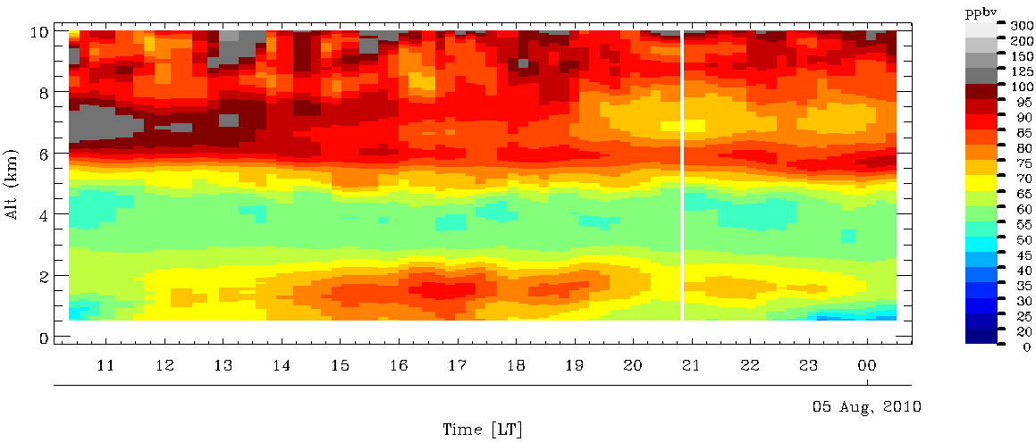
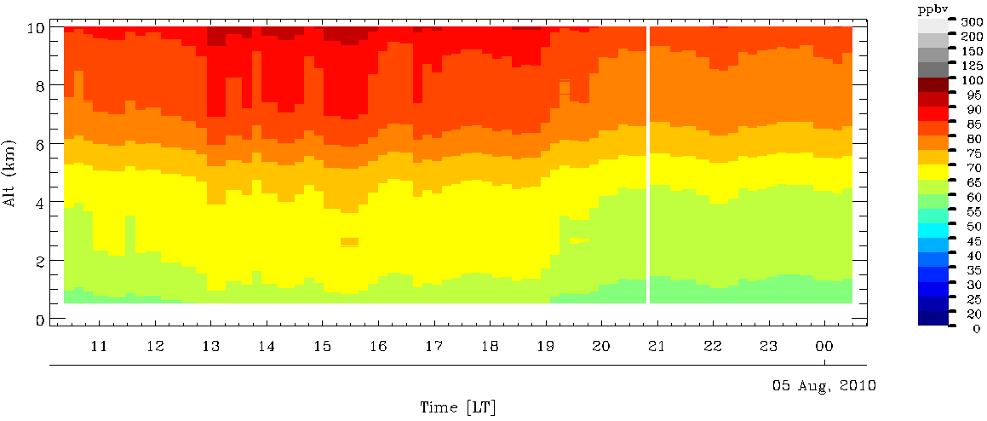
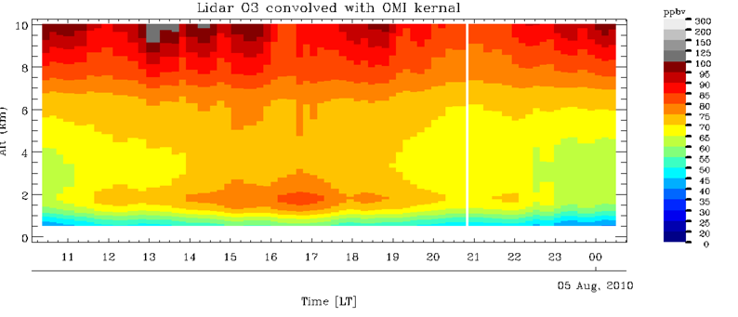
TORONTO
TOLNet Complements TEMPO
GSFC
AMES
ESRL
LaRC
JPL
UAH
TOLNet/RO₃QET observation at Huntsville on Aug. 4, 2010. Note distinct upper troposphere and PBL layers.
RO₃QET observation convolved with TEMPO UV averaging kernel to simulate the space-borne observation, which captures most of the UT layer but little of the PBL.
RO₃QET observation convolved with TEMPO UV & Visible enhances the fidelity of both UT and PBL layers, but does not capture the lowest 1km very well. X. Liu et al.
Conclusion: TOLNet provides measurements to not only validate TEMPO, but also to complement TEMPO, especially in the PBL.
Notes:
Top slide: the “truth” as measured by high spatio-temporal-resolution lidar.
Middle: What TEMPO will see with only UV retrieval.
Bottom: What TEMPO will see with both UV and Visible retrieval, but the visible part of this retrieval is difficult and dependent on knowledge of albedo and other geophysical variables.
Conclusion: TOLNet provides measurements to not only validate TEMPO, but also to complement TEMPO, especially in the PBL.

Slide 17
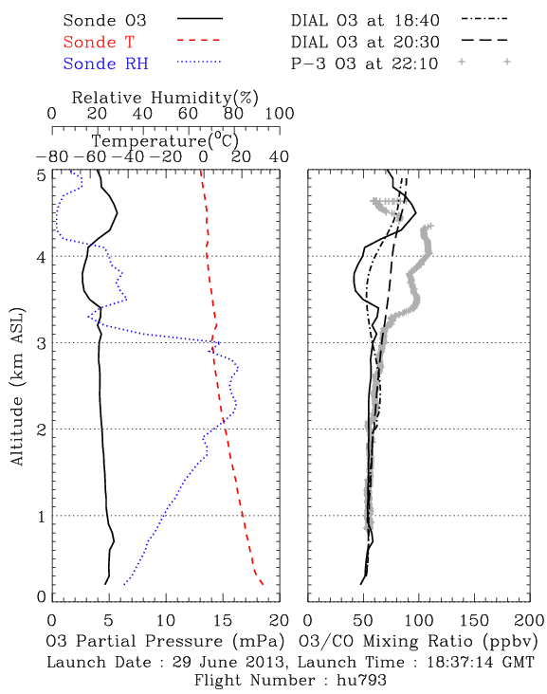
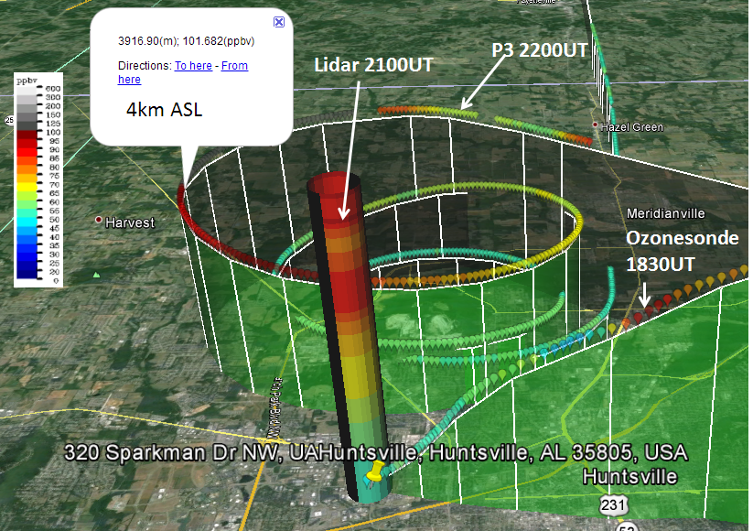
TOLNet/UAH RO₃QET validation with P-3B and ozonesondes during 2013 SENEX
TORONTO
AMES
ESRL
GSFC
JPL
LaRC
UAH
June 29, 2013
due to real ozone variations
Lidar, sonde, P-3 measured ozone mixing ratio shown on the GOOGLE map.
The left panel shows the ozone, temperature, and relative humidity measured by the ozonesonde launched at 18:37 showing atmospheric laminar structure. The right panel shows the comparison of ozone profile measured by the ozonesonde, the profile measured by the P-3, and two DIAL ozone profiles measured at two different times (one close to the ozonesonde launching time and the other close to the time P-3 overpassing Huntsville). <about 8 min for P-3 HSV spiral>
Notes:
UAH uses a combination of ozonesondes and aircraft observations to validate it ozone profiles. Spatial variability in x, y, and z pose continual challenges in accurately assessing the measurements and natural variability.

Slide 18
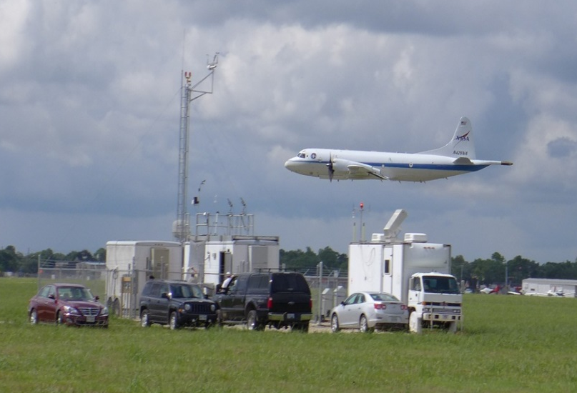
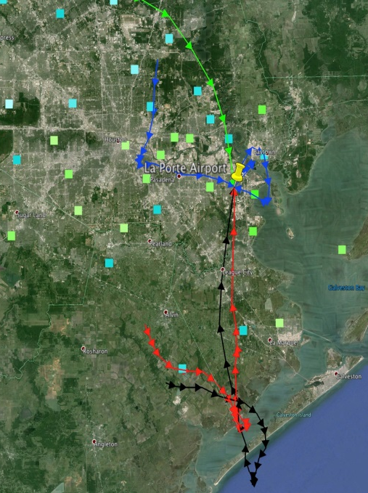
TOLNet/NOAA/ESRL TOPAZ
Land-sea breeze affects Houston ozone levels
TORONTO
AMES
ESRL
GSFC
JPL
LaRC
UAH
DiscoverAQ Houston: LaPorte Airport site
DiscoverAQ TX
25 Sep 2013
TCEQ met
tower
NASA P3-B
TOPAZ
lidar
EPA trailer
Light winds and recirculation of pollutants by the land-sea breeze led to very high afternoon O₃ concentrations.
Titration of O₃ in the shallow morning boundary layer was followed by a quick increase in O₃ due to photochemical production.
A rapid rise of the boundary layer around midday caused a temporary drop in O₃ levels as cleaner air from aloft was mixed down.
In the evening, the sea breeze brought in lower-O₃ air in the lowest few hundred m AGL, leaving a “dirty” residual layer aloft.
12-h wind profiler back trajectories
Notes:
Houston experiences significant land-sea breeze effects that comsprie with the local photochemistry to produce highly variable ozone amounts. Measurements of the vertical-temporal morphology by the TOLNet TOPAZ (ESRL) lidar help diagnose the processes responsible.

Slide 19


TORONTO
TOLNet/NASA/GSFC TROPOZ
PBL Ozone in Beltsville, MD 2015
GSFC
AMES
ESRL
LaRC
JPL
UAH
TROPOZ characterizing high O₃ during Summer 2015 in BW region
Smoke?
Residual Ozone Layer
Well mixed 90 – 120 ppbv ozone in PBL
Ozonesonde
Ozonesonde
Surface Monitor
Top: The GSFC TROPOZ was deployed to Beltsville, MD to make measurements in support of Maryland Department of the Environment (MDE) air quality forecasts. On June 10, 2015 (one day before above time-series) heavy smoke originating from Canadian wildfires (most likely from Saskatchewan) impacted the boundary layer throughout the Mid-Atlantic region, bringing additional ozone precursors to the region. The ozone series on June 11, 2015 (above) shows large ozone enhancement with ozone concentrations reaching 90-120 ppbv, which were also verified with the ozonesonde. The impacts at the surface were also observed and several surface monitoring sites, including the Beltsville, MD monitor, exceeded the NAAQS 8-hr 75 ppbv ozone standard. Importantly, this was the worst day for ozone in MD since 2012.
Notes:
Example from TROPOZ in Beltsville, MD measuring high ozone in the PBL during the day and the resulting nighttime residual layer of high ozone that affects the next day’s PBL and surface amounts. In conjunction with MD Dept. of Environment.

Slide 20
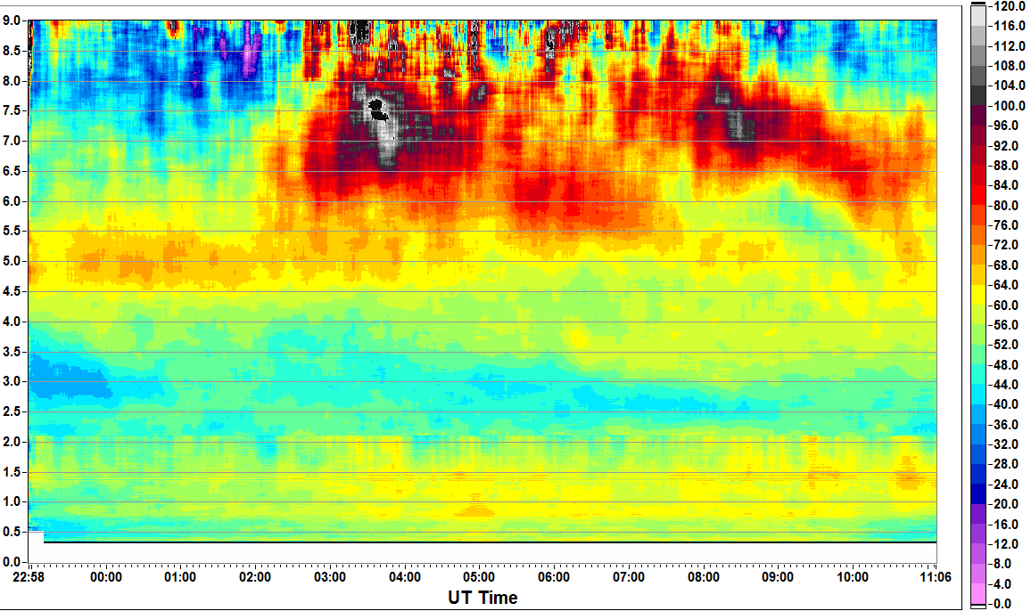
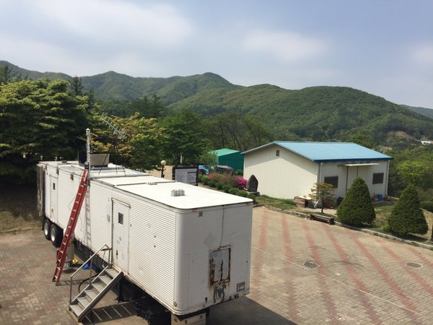
TOLNet
TORONTO
AMES
ESRL
GSFC
GSFC TROPOZ DIAL at
Taehwa, Korea 4 May, 2016
JPL
LaRC
UAH
Altitude (km asl)
Ozone Mixing Ratio (ppbv)
O3-Sonde Launch
DC-8 Overpasses
TOLNet/TROPOZ measurements at the Taehwa site in support of all aircraft overpasses (black triangle denotes DC-8). Following a deep cyclonic depression and jet stream trough over the Korean Peninsula, we observed stratospheric air in the free troposphere. Ozone remained near 40-50 ppbv at the surface for nearly the entire day. O3-sonde was launched near 03:30 UT to further characterize the stratospheric intrusion. Balloon profile indicated ozone near 200 ppb at 8 km, coupled with very dry and cold air conditions.
Notes:
McGee and Sullivan observations at KORUS last week.

Slide 21
TOLNet
TORONTO
AMES
ESRL
GSFC
GSFC TROPOZ DIAL at
Taehwa, Korea 30 May, 2016
JPL
LaRC
UAH
Notes:
McGee and Sullivan observations at KORUS last week.

Slide 22
Geo TASO

Slide 23
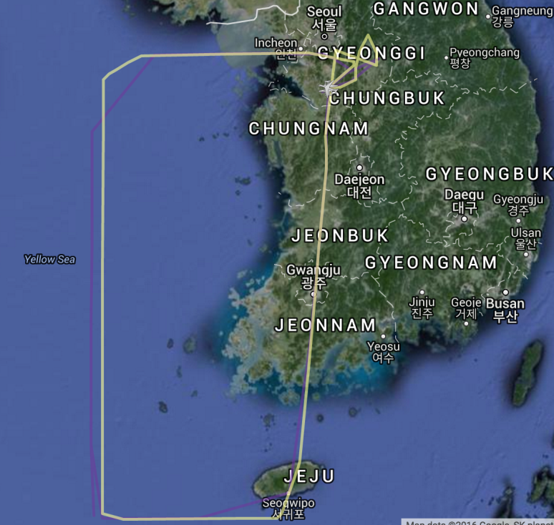
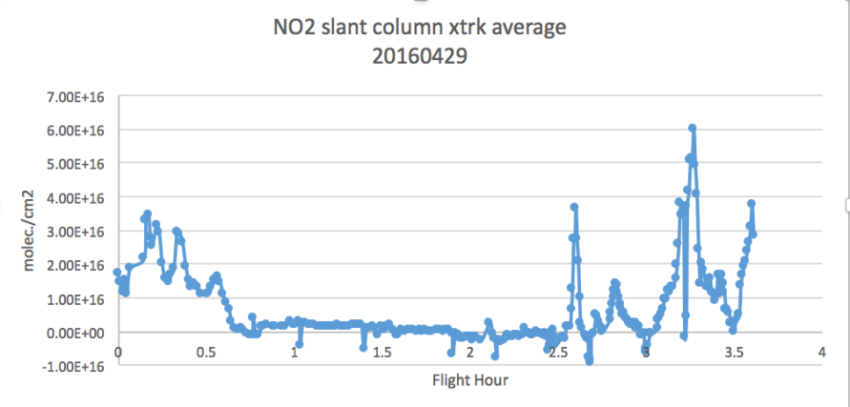
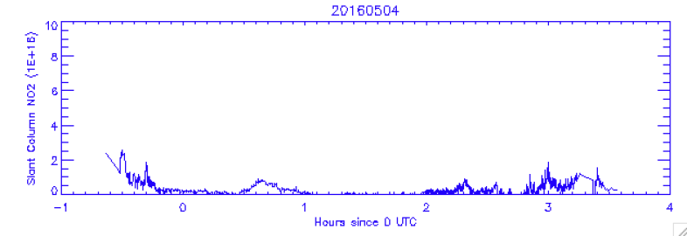
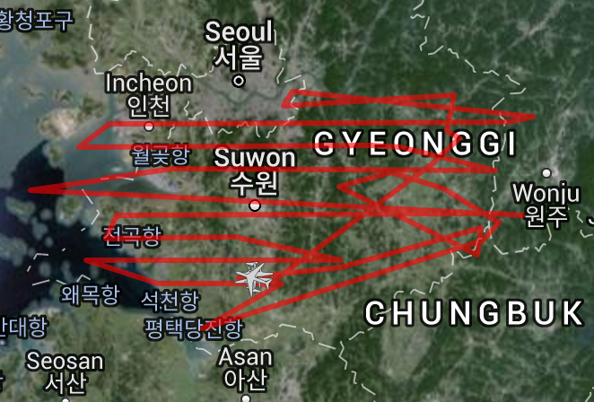
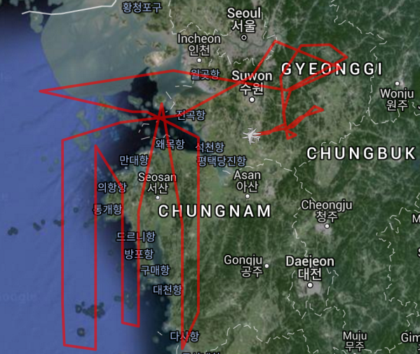
GeoTASO: KORUS-AQ quick look retrievals and flight tracks
0.5 km² binned nadir pixel
Enhanced NO₂ build-up: 29APRIL
Reference scene
Post frontal passage clean background: 04 May
Survey type tracks
Mapping type rasters:
10 May & 21 May (includes coordination with KORUS-Ocean Color)
Quick look available after June 5th.

Slide 24
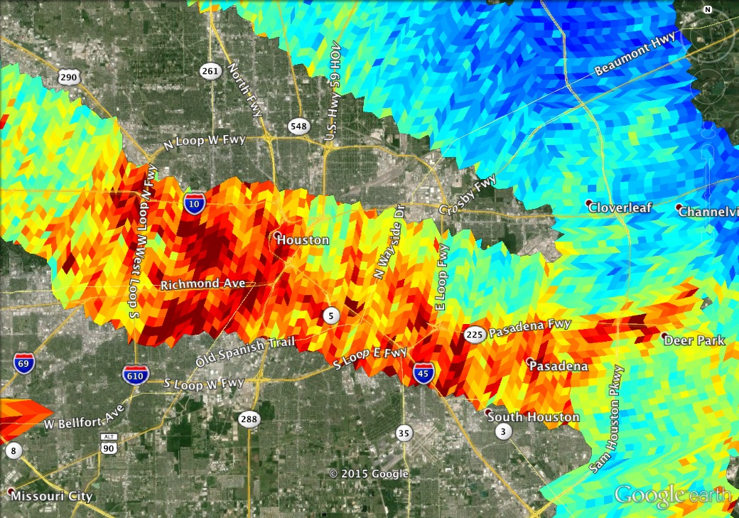
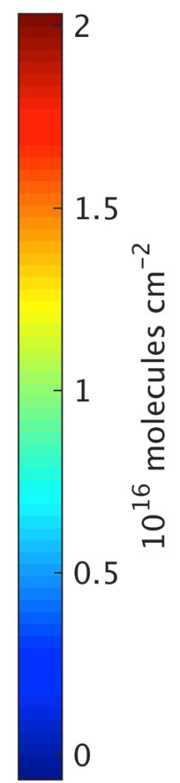
NO₂ over Downtown Houston
13 September 2013
Vertical
Column

Slide 25
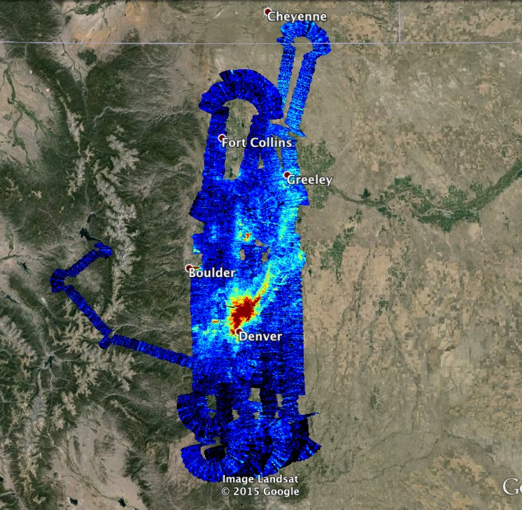
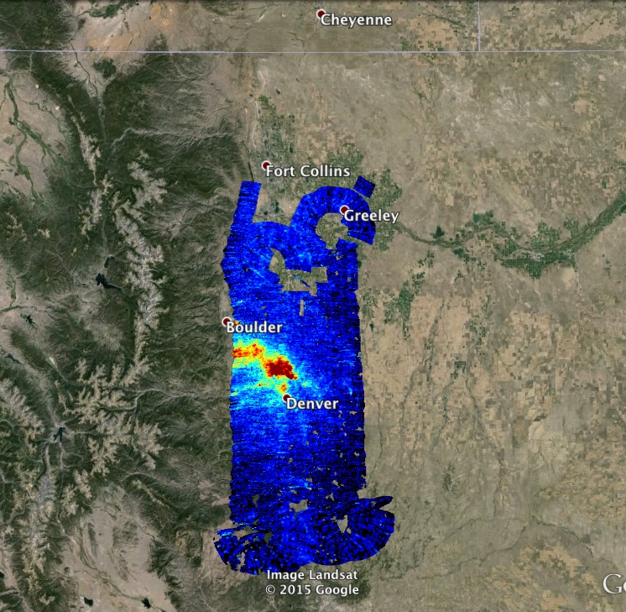
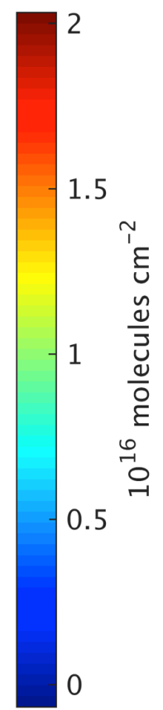
NO₂ over Denver, Raster Scans
2 August 2014
8:00 – 11:30 AM Local time
2:00 – 4:00 pm local time
Slant
Column

Slide 26
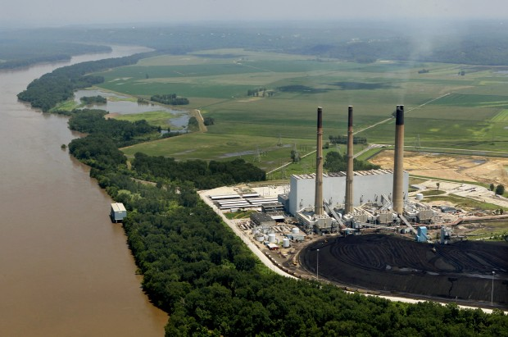
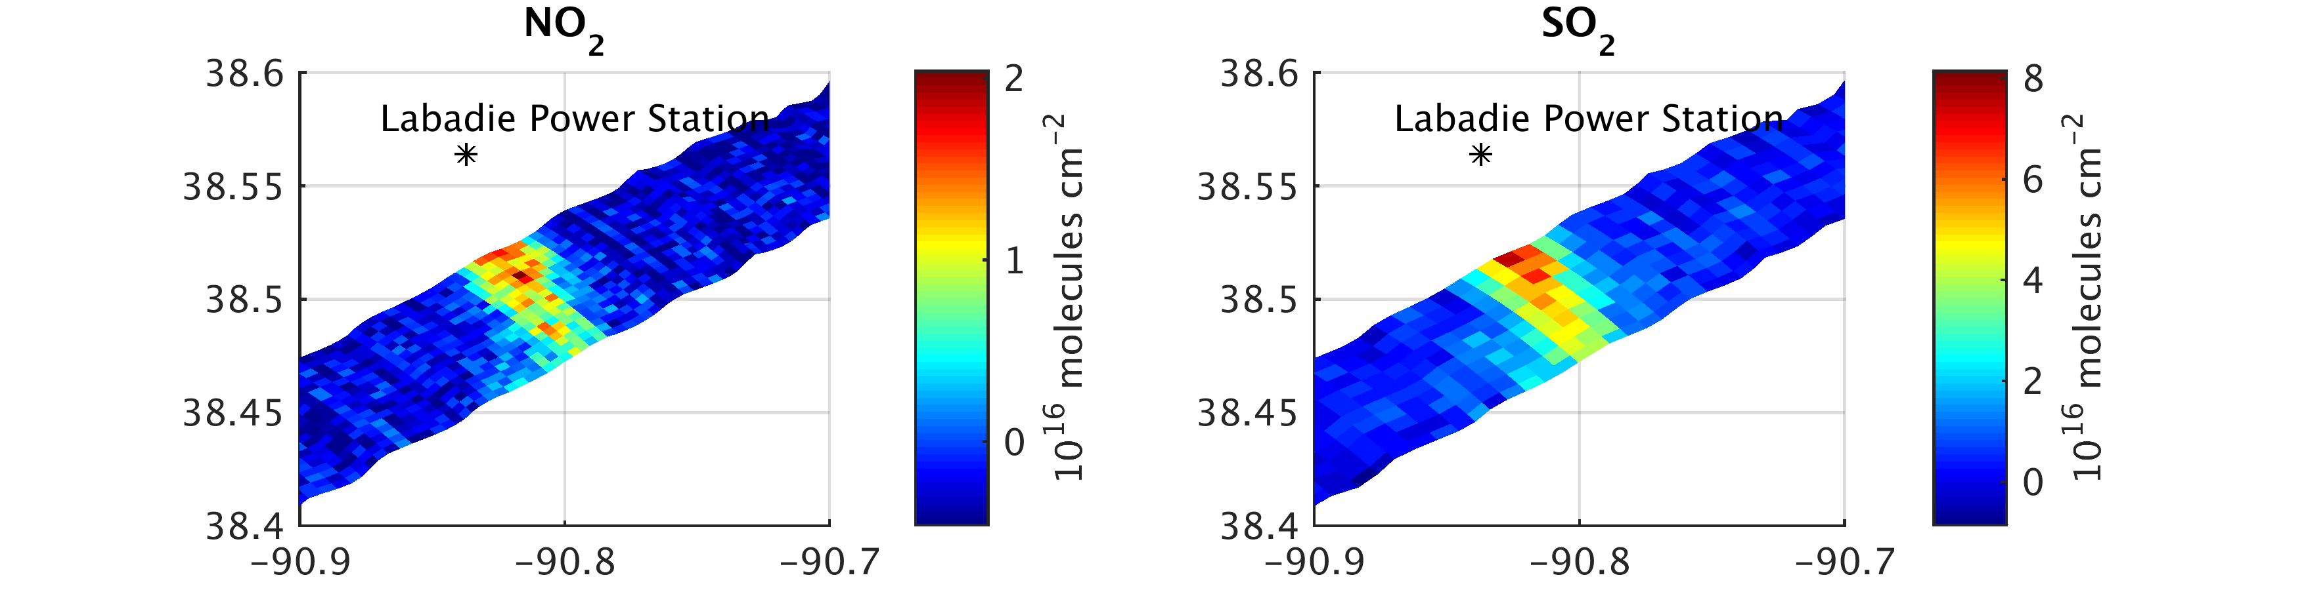
08/13/2014: Overpass of Labadie Power Station, Missouri
GeoTASO measured coincident slant columns of NO₂ and SO₂ downwind from Missouri’s largest coal-burning power plant, on transit back to Virginia
Photo by J.B. Forbes

Slide 29
ACAM/GCAS

Slide 30
ACAM/GCAS intercomparisons
ACAM HCHO: Gonzalo has done some comparison of ACAM HCHO (SAO & NASA products) with P3B measurements and OMI observations for the Baltimore-Washington DC campaign. Previously, Cheng Liu has done ACAM HCHO/NO2 comparison with Pandora/OMI as presented last year at the TEMPO science team meeting.
GCAS: Caroline has done retrievals of NO2 SCDs for the Houston campaign and have done some comparison with GEOTASO NO2. The results were published (now accepted for AMT): Nowlan et al., Atmos. Meas. Tech. Discuss., 8, 13099-13155, doi:10.5194/amtd-8-13099-2015, 2015.
In addition, Hyeong-Ahn Kwon (PhD student of Rojin Park from National Seoul University) have has GCAS HCHO retrievals for the Houston campaign and showed good comparison with the P3B measurements.
GEOTASO: Caroline has done NO2 retrievals and validation from both Houston and Denver campaigns. She has also done preliminary HCHO retrievals for the Denver campaign.

Slide 31

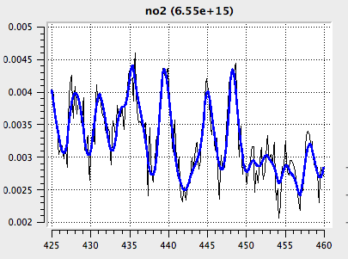
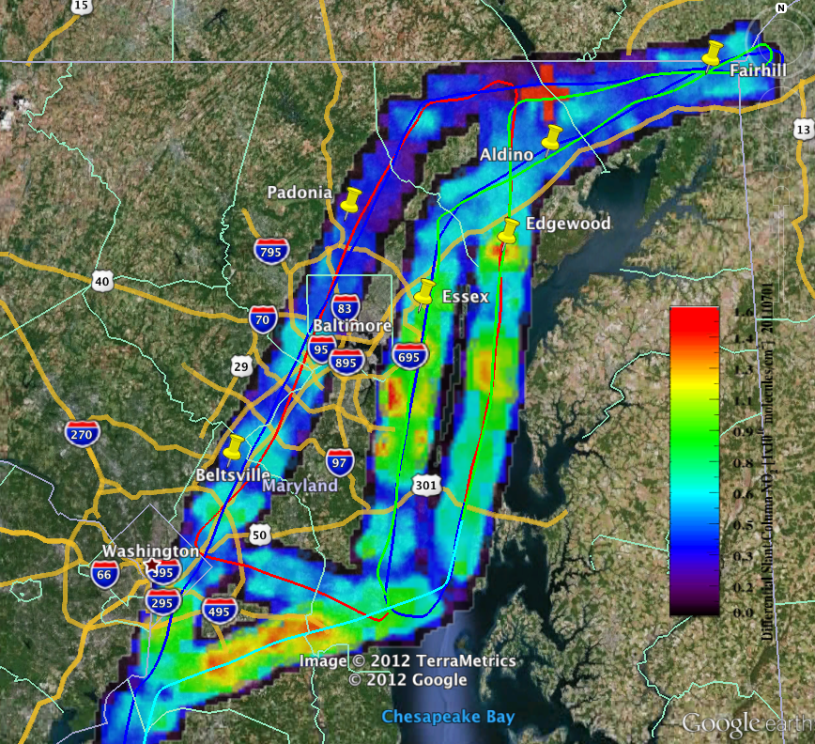
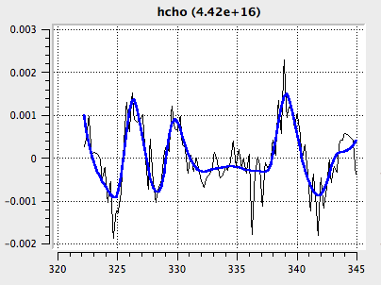
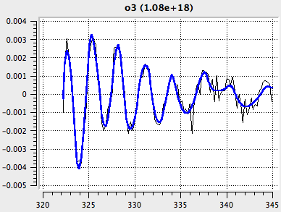
ACAM/GCAS Measurements of NO₂, CH₂O, and O₃ during Discover-AQ
GSFC
Scott Janz
Matt Kowalewski
Sam Xiong
Kent McCullough
Nickolay Krotkov
Lok Lamsal
SAO
Xiong Liu
Cheng Liu
Caroline Nowlan

Slide 32
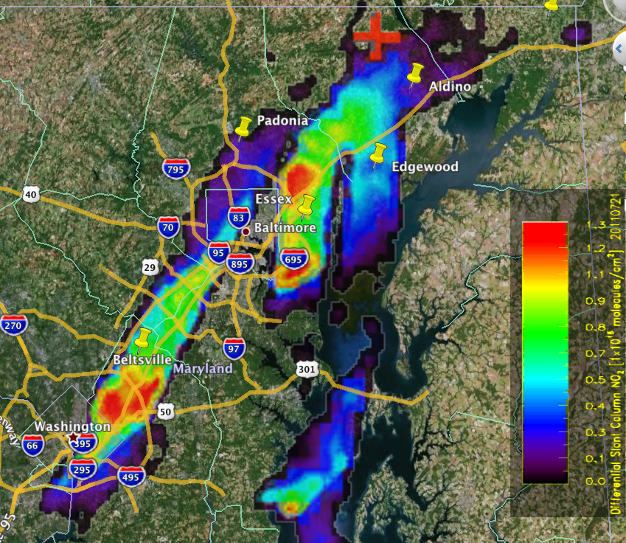
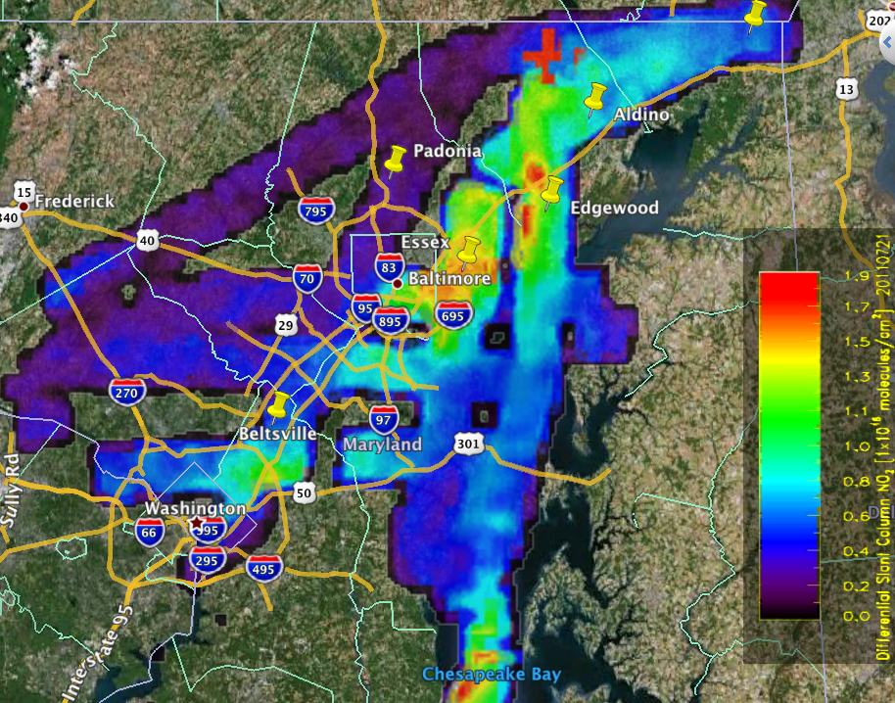
ACAM Spatial/Temporal Variability NO₂ July 21st
MD Deployment
Morning
0.005° x 0.005° grid of 3 km² average, differential slant column abundance. “Clean scene” reference at cross.
Afternoon

Slide 33
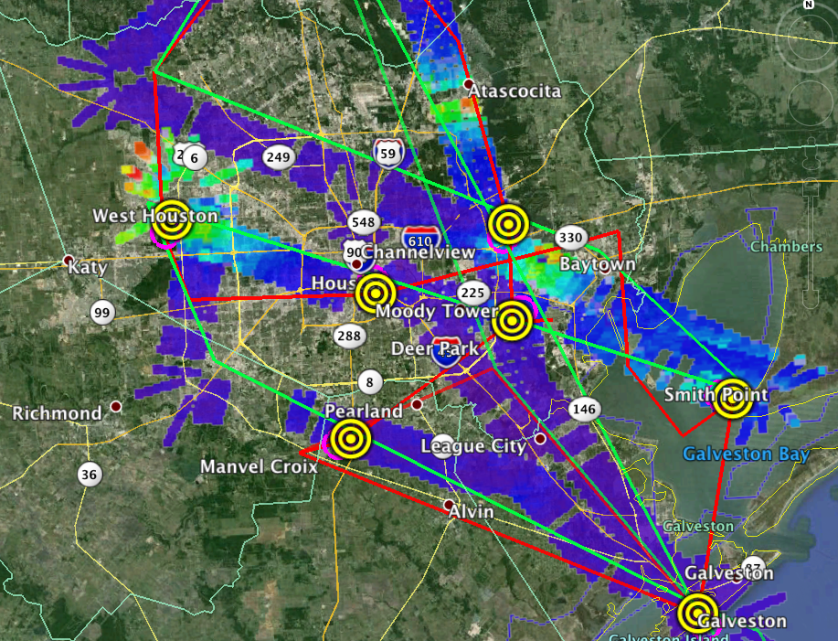
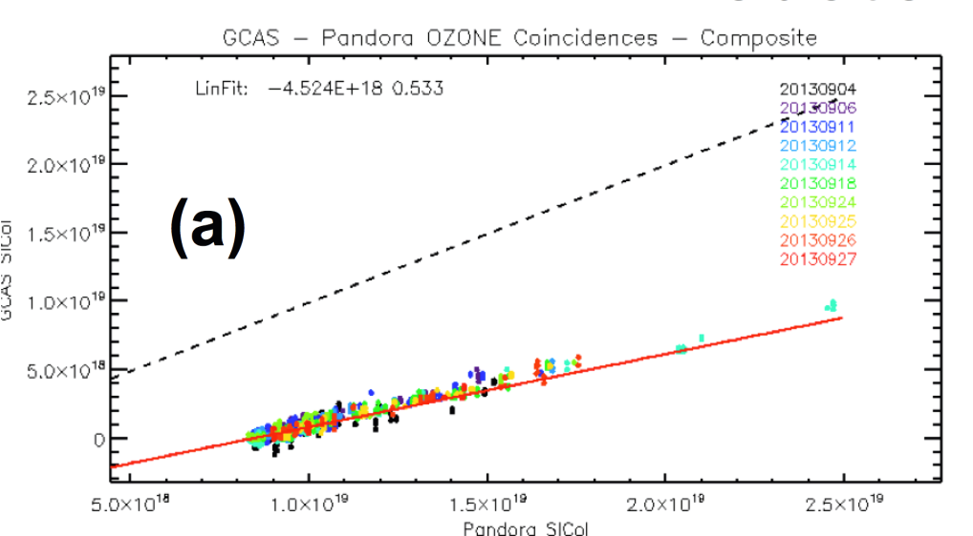
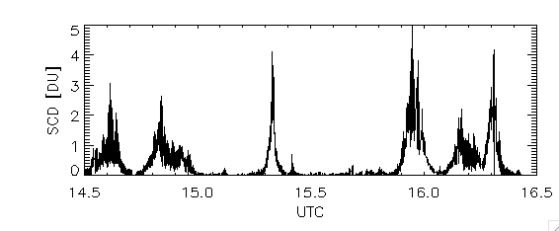
GCAS NO₂ Sept. 25th, O₃ Pandora Comparisons
Houston Deployment
Composite comparison with Pandora O3 overflights – all days/stations
Differential slant column abundance shows good correlation with Pandora slant column – absolute offset due to viewing different air mass.
Differential slant column abundance – example of large gradients. GCAS is 3x more sensitive than ACAM for a given spatial binning scheme.

Slide 34
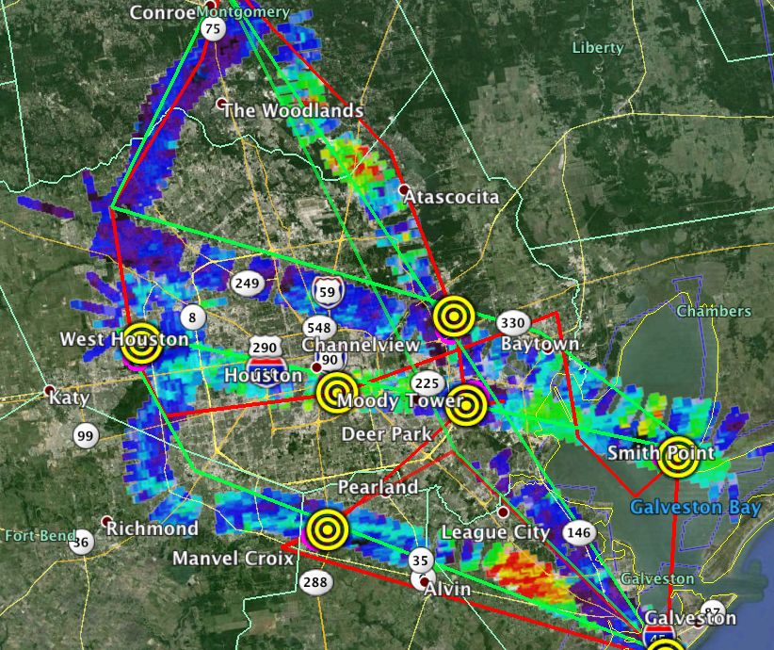
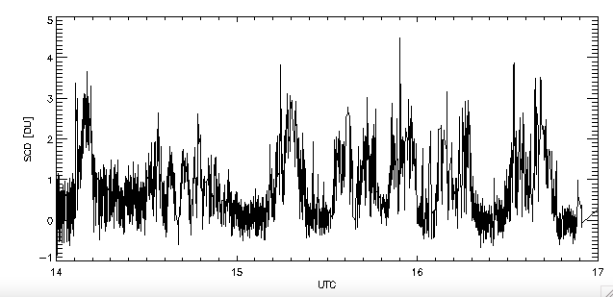
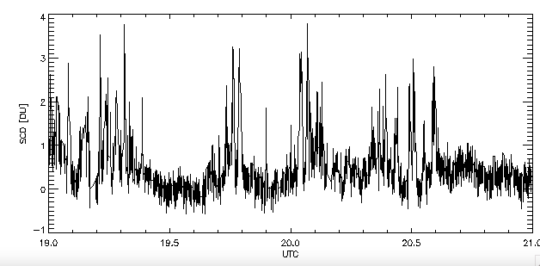
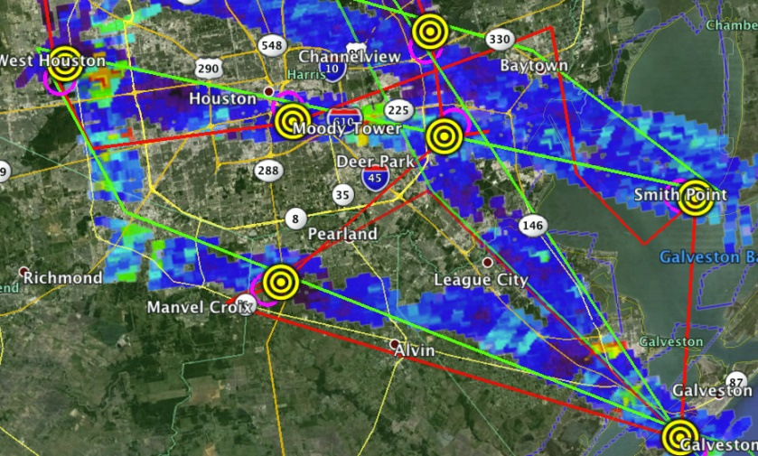
GCAS CH₂O Sept. 24th
Houston deployment
Morning
Afternoon
Highest levels of CH2O seen of the four deployments. Comparisons with DFGAS complicated by cloud interference.

Slide 35
Formaldehyde

Slide 36
CH₂O Validation Challenges
Validation challenges for TEMPO CH₂O column measurements:
Adequacy (or lack) of correlative measurements - vertical distribution (especially within the BL)
Impact a priori vertical diurnal profiles
Aerosols and clouds
Albedo changes and spatial gradients
Sources of independent sources of CH₂O measurements:
Satellite data sets from independent sensors: TropOMI
Aircraft observations; GCAS, GeoTASO, Aircarft in-situ profiles
Ground-based measurements; Pandora
For CH₂O a-priori vertical profile shapes have the largest systematic impact on the satellite column errors due to the strong decrease of the satellite UV measurement sensitivity near the surface.

Slide 37
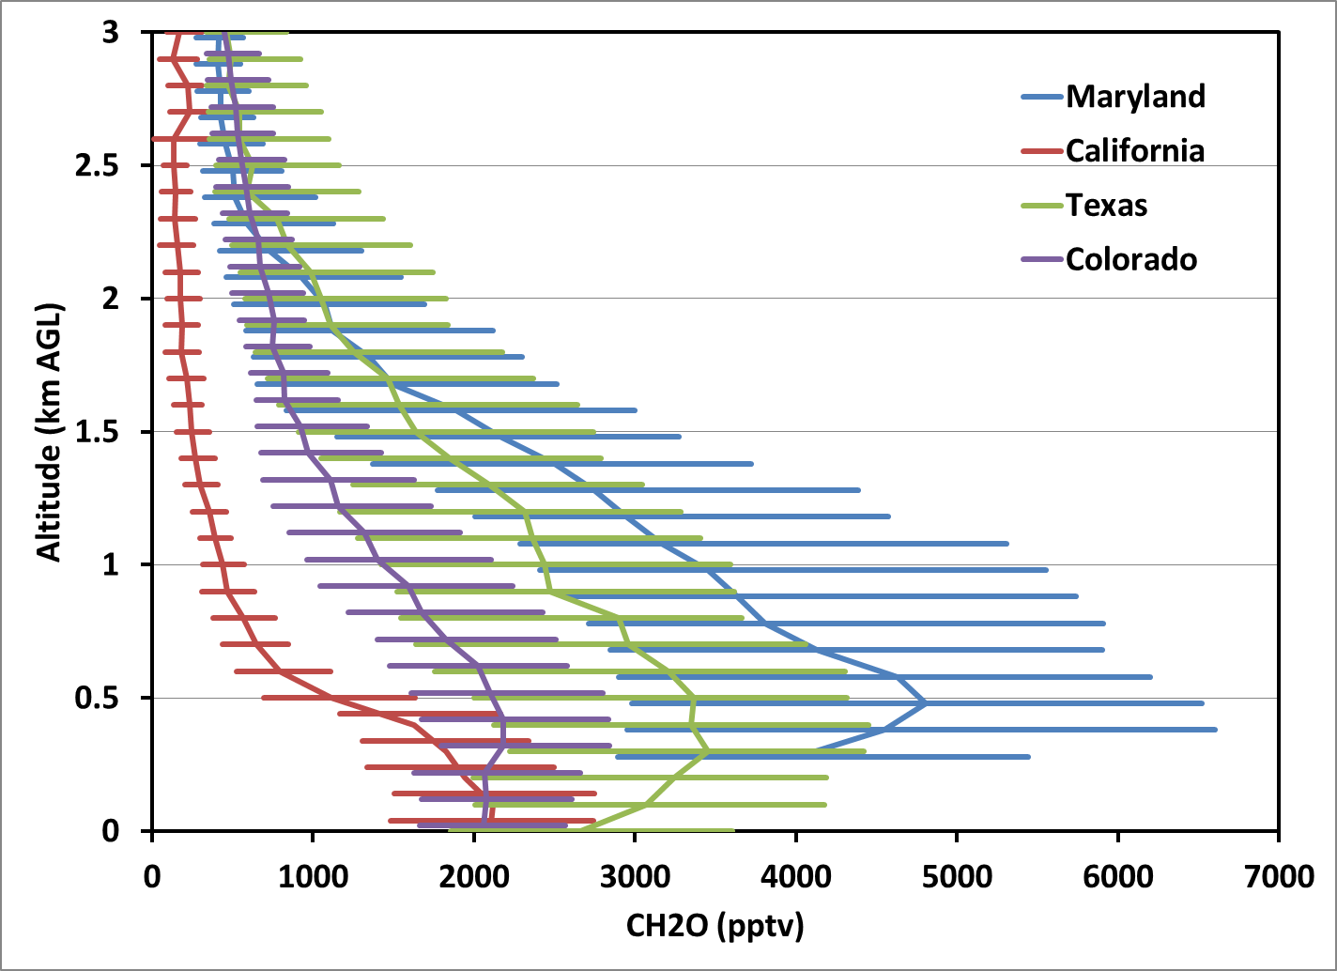
DISCOVER-AQ
P-3 Median CH₂O Profiles
37

Slide 38
Federated Networks

Slide 39
Rationale for pursuit of a Federated Activity for TEMPO L2/L3 Validation
A federated approach to validation/evaluation of L2/L3 geophysical variables using existing air quality network infrastructure could help promote early acceptance of L2/L3 data products, especially given the potential short operational life of TEMPO.
Current proposed changes by the EPA to the existing Photochemical Assessment Monitoring Station (PAMS) Network provides a unique opportunity to:
  Leverage existing/expanding infrastructure already required and funded by EPA via the Clean Air Act.
  Develop continuous (24/7) TEMPO correlative data validation sites in the areas with the worst O₃ pollution.
  Help foster more significant interaction between TEMPO science team and the air quality agencies.
  Build on existing AQ long term datasets in urban areas, and make TEMPO data products more relevant to air quality managers.

Slide 40
TEMPO relevant changes under PAMS Network Re-Engineering
Required PAMS
  Issue: Standard NOx measurement technology is known to have positive interferences from other non-NOx species (HNO₃, PAN, etc.) and does not measurement NO₂ directly.
  Proposed Solution: Add a “true NO2” measurement at required PAMS-NCore sites.
  Issue: Formaldehyde (CH₂O) is now recognized as one of the most important ozone precursors
  Proposed solution: Restart carbonyl measurements which includes CH₂O, still not very useful for TEMPO. Option to add commercial CH₂O measurements methods for high time low detection limit (ppb).
  Issue: Existing radar profilers with RASS temperature profilers at PAMS sites are old and in need of replacement or expensive upgrades.
  Proposed solution: Addition of ceilometers to provide continuous mixing height via aerosol backscatter (910 nm). Can also provide aerosol layer heights and cloud heights up to 15+ km.

Slide 41
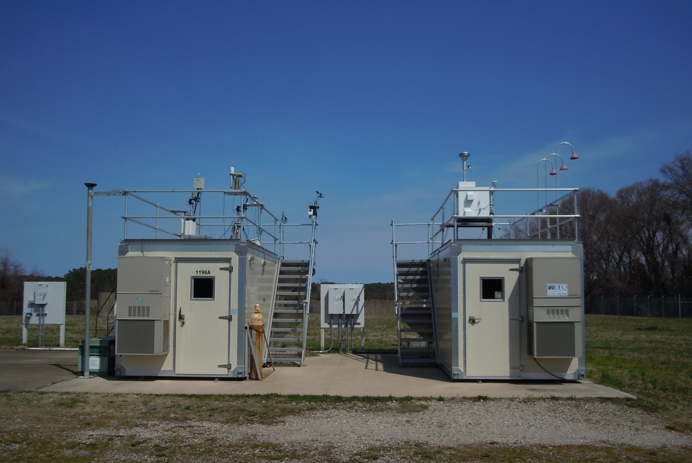
Prototype Instrument Suite for
Ground Validation Sites
EPA gas sample inlet for NO, NO2, and O3 and NOy
VADEQ gas sample inlet for SO2, O3, NOx, and CO
NASA AERONet cimel
Pandora UV/VIS Spectrometers
NASA-EPA
Shelter
VADEQ
Shelter
EPA CL-51 ceilometer
(mixing heights)
Office ofi Research and Development
National Exposure Research Laboratory

Slide 42

Challenges and opportunities for remote sensing of air quality: Insights from DISCOVER-AQ
Jim Crawford¹, Ken Pickering², Lok Lamsal², Bruce Anderson¹, Andreas Beyersdorf¹, Gao Chen¹, Richard Clark³, Ron Cohen⁴, Glenn Diskin¹, Rich Ferrare¹, Alan Fried⁵, Brent Holben², Jay Herman⁶, Ray Hoff⁶, Chris Hostetler¹,
Scott Janz² , Mary Kleb¹, Jim Szykman⁷, Anne Thompson², Andy Weinheimer⁸, Armin Wisthaler⁹, Melissa Yang^{1,} Jay Al-Saadi¹
¹ NASA Langley Research Center, ² NASA Goddard Space Flight Center,
³ Millersville University, ⁴ University of California-Berkeley, ⁵ University of Colorado-Boulder, ⁶ University of Maryland-Baltimore County,
⁷ Environmental Protection Agency, ⁸ National Center for Atmospheric Research, ⁹ University of Innsbruck
http://discover-aq.larc.nasa.gov/
Notes:
Things to mention:
Hope this isn’t the first time this week that you are hearing about DISCOVER-AQ. Co-investigators are listed, but many others contributed to the success of the project and have been responsible for over 70 presentations this week. In many cases, they have delved into many of the details of the observations we have collected over the last 4 years. For this brief talk, I will focus more broadly on how the measurements
Much greater detail can also be found at the website along with the data which is already public for the first three campaigns and will be available for our recent Colorado campaign early next year.

Slide 43
Implications for TEMPO (2 of 2)
So what do we do?
  Science studies related to TEMPO observations are a logical priority for tropospheric chemistry programs post-launch
    Analysis of DISCOVER-AQ, KORUS-AQ, TROPOMI and other data sets will help clarify priorities for pre- & post-launch airborne campaigns related to TEMPO
    Spatial representativeness, diurnal influences on products, vertical profile shapes, …
  Get in line and build advocacy: NASA campaign concepts typically start as community grass-roots efforts leading to development of white papers
  Consider Earth Venture proposal?
  Continue preparatory activities as funding permits (GEO-CAPE, HQ R&A, possibly HQ Applied Science, possibly TEMPO)

Slide 44
Thoughts from Jim Crawford on Possible Approaches
There are at least two initial approaches to take.
One is to leverage what we have learned from DISCOVER-AQ, KORUS-AQ, etc. to define a field campaign to support TEMPO. In this case, you would hope to be able to get airborne as soon as possible after TEMPO launches.
Another approach would be to get the right surface measurements in place and use them to identify the locations where TEMPO needs the most help. This would delay a field campaign in favor of getting a chance to evaluate TEMPO performance using ground obs, sondes, Pandora, TROPOMI, etc. Such a campaign would hopefully be more targeted on TEMPO performance, but would also hope to see TEMPO observations continue beyond the initial 2-years to take advantage of what is learned.

Slide 45
Applications Workshop
Workshop Session Topics
Air-quality Forecasting and Evaluation
Planning and Assessment: Policy, Historic Analyses, Exceptional Events
Emissions
Health and Exposure
Ozone Crop Damage
Dust, Smoke, Volcanic Ash
Lightning NOx
Training and User Support
Confirmed Speakers
Kelly Chance/SAO Tianfeng Chai/NOAA Pawan Gupta/GSFC Denise Mauzerall/Princeton Jim Szykman/USEPA Lihua Wang/UAH | Greg Carmichael/U. Iowa Greg Frost/NOAA/ESRL Shobha Kondraguta/NOAA Ivanka Stajner/NOAA Jeff Vukovich/USEPA

Slide 46
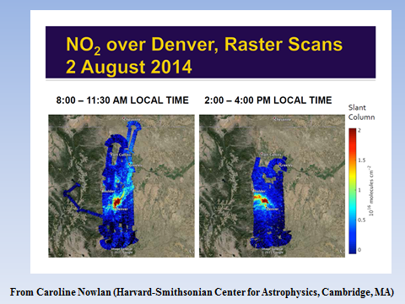
Workshop Goals
Provide common ground for air-quality practitioners to converge toward a system that will realize the benefits of TEMPO as soon as it is launched and operational.
Commence a conversation between air-quality forecasters, users, and managers and the TEMPO data/product-provider community to proceed toward being able to:
  Use current systems (space-borne, surface networks, model/synthetic calculations) to emulate future TEMPO capabilities.
  Define expected TEMPO product suite to air-quality forecasters, users, and managers and identify specific applications/operations for evaluation.
  Establish a feedback loop for the TEMPO Science Team to understand and supply products that users need or want.
  Transition TEMPO products to users.
Key elements to successful transition
  Shared interest to improve forecasts by infusing new technology and applying emerging research techniques
  Identify common goals and objectives from strategic plans
  Advocacy for both the push and pull of technology from the office level to Senior Agency/Dept. Leaders and Managers
  Collocation of researchers and end users
  Knowledge of and/or access to users’ Decision Support System
Points of Contact:
UAH: Mike Newchurch, Mike.Newchurch@uah.edu and Laurie Collins, Laurie.Collins@nsstc.uah.edu
MSFC: Brad Zavodsky, Brad.Zavodsky@nasa.gov and Sue Estes, Sue.M.Estes@nasa.gov

Slide 47
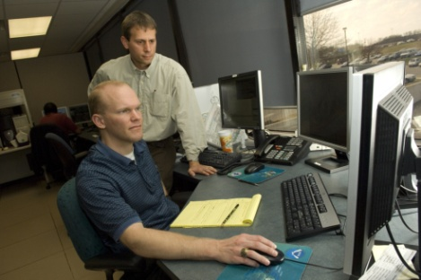


Short-term Prediction
Research and Transition (SPoRT) Center
Mission:
Transition unique NASA observations and research capabilities to the operational community to improve decision support for regional and local scale challenges.
Benefits:
Demonstrate utility of NASA climate sensors for real-time applications to benefit society
SPoRT has transitioned 40+ products to operational forecasters since 2002
Total O₃ products for identifying stratospheric air intrustion that can lead to elevated background levels
Composite AOD product that blends GEO and LEO satellite data into a near-global real-time product
Multispectral imagery (i.e., RGBs) used to detect dust

Slide 48
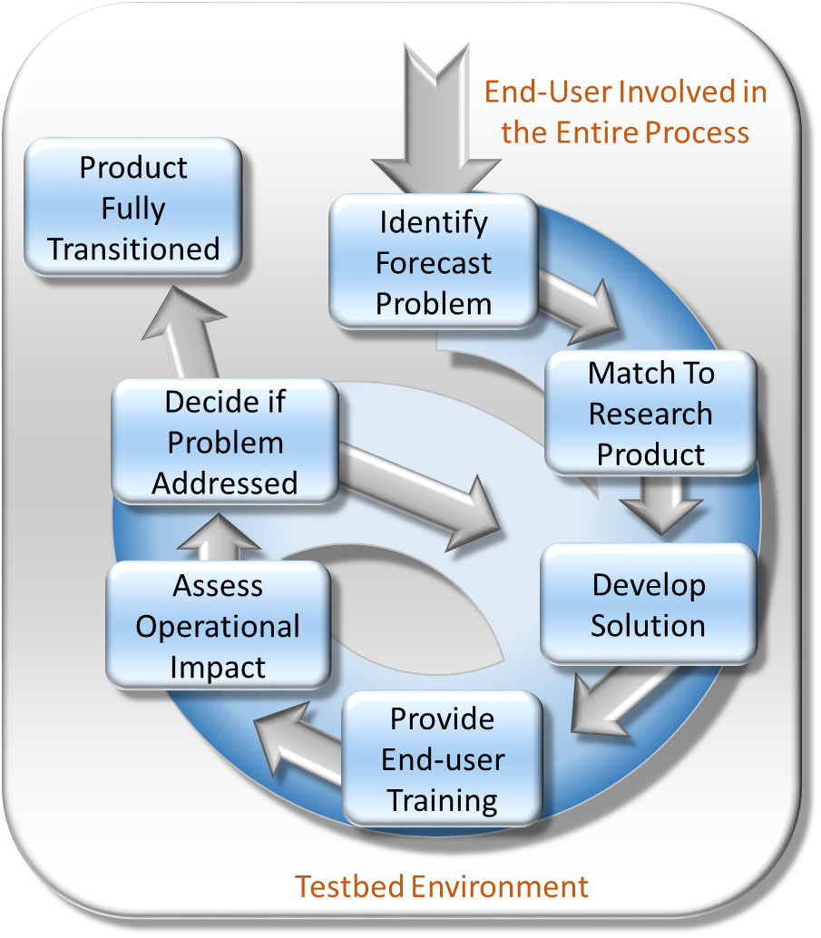
SPoRT R2O/O2R Paradigm
Bridge the “Valley of Death”
Can’t just “throw data over the fence”
  maintain interactive partnerships with help of specific advocates
  integrate into user decision support tools
  Create product training
  Perform targeted product assessments
Use experimental datasets and proxies in advance of operational use to demonstrate utility and impact
Concept has used to successfully transition a variety of satellite datasets to operational users for more than 10 years
Other groups in the community have adopted this paradigm

Slide 49
Support for TEMPO
SPoRT can assist the TEMPO mission with R2O:
  Provide guidance on data formatting and metadata to ensure usefulness at operational centers – especially as early proxy data formats are made available
  Work with operational centers to identify unique applications of TEMPO
  Coordinate feedback between product developers, science team, and end users on needed product improvements
  Facilitate improvements to decision support tools (e.g., web-based visualization tools) for displaying TEMPO and other NASA data for use by environmental and health-based operational decision making (e.g., EPA, state agencies)
  Leverage existing partnerships with CDC to provide data on harmful tropospheric pollutants
SPoRT is also engaged in a variety of relevant data assimilation activities
  Partner with NOAA to perform assimilation and CTM sensitivity studies using operational modeling platforms

Slide 50
Conclusions
Observations from a variety of instrument (Pandora, Geo TASO, ACAM/GCAS, TOLNet, DISCOVER-AQ, et al.) of the TEMPO species demonstrate significant temporal and 3-d spatial variability in the trace species. Mapping these spatio-temporal gradients onto the TEMPO observation kernels will be critical for quantitative validation.
Pandora, the primary validation instrument, is maturing well and propagating across the continent.
Geo TASO and ACAM/GCAS a/c simulator data well characterizes the spatial and temporal variability of trace gases
TOLNet is also maturing well and provides excellent observations of the high-fidelity spatio-temporal evolution of tropospheric ozone
Federated networks making correlative observations will provide valuable validation
Modeling activities (i.e., assimilation, spatio-temporal gradients, attribution, climatologies, etc.) are not directly supported by TEMPO validation, but are critical to assess our understanding of the TEMPO observations.
The minimum-required Pandora validation is reasonably tractable, but any additional activities, especially validation campaigns will require additional resources: It is time to build the constituency (cf., Jim Crawford).

